Slide 1
Bedorven of niet bedorven?
Thema: infecties

Slide 2
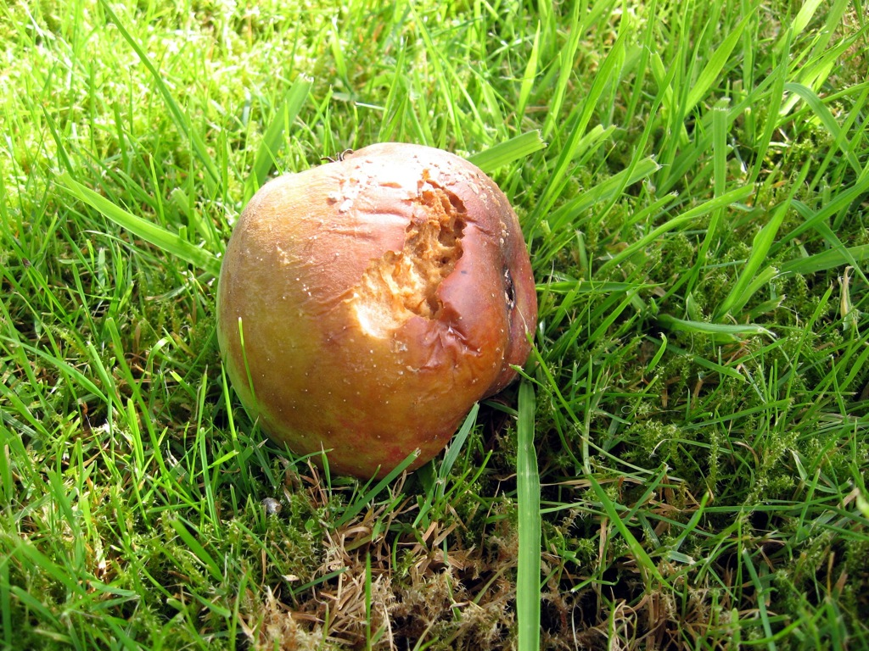
1. Bedorven of niet bedorven?
Bron: Mars https://www.flickr.com/photos/hpvmars/1297735794/in/photolist-8ry7TF-8shpxE-w1YFD1-qeQC9B-jGtrGh-g8FTZq-pqekR4-bgPYhT-6o2S8f-6iSc1-6y2aCU-jGu2m3-8DUxyM-osZF8P-6J9QxA-33cwM3-4coneZ-cWdfKQ-6PzdsP-azsG3v-9v2jsU-4FQTmx-odExS-phEeqW-2a5nA-wZpEm7-cUvR7f-2YFeD5-a2bN
Notes:
Bedorven (appel)

Slide 3
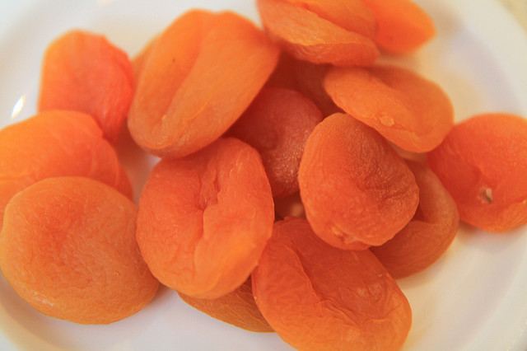
2. Bedorven of niet bedorven?
Bron: Muttsz - https://www.flickr.com/photos/mutsz/5461646516/in/photolist-9jCnef-7Jz2Sc-9AeqNB-6qbyZn-9jDsBy
Notes:
Niet bedorven: gedroogde abrikoos

Slide 4
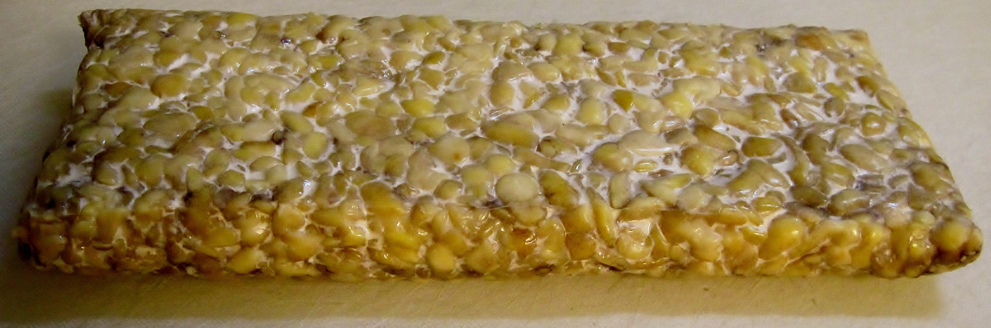
3. Bedorven of niet bedorven?
Bron: Gloria Cabada-Leman https://www.flickr.com/photos/67238971@N04/7375191830/in/photolist-ceHMzQ-4dpzjt-p5D73t-ceHMHN-pn7Ke5-9J6Tm5-3wwy3f-qgxpc2-qXcjus-hWAXUm-p5Doqu-dhUB2P-bM6X4p-pk7hzj-9crbT4-6H9VMJ-eRtYba-ahUU1i-6F2Hvg-DSLU9-pR4iEE-dAHXmh-8mpSj1-6u9nhF-d43bFh-4ue6FC-91JjGq-9ozu1Z-9J6TG9-eRFmqW-7Jig3D-9KM5DV-4yPe4e-avWQHU-eRtY3i-2syVHv-bwQEdR-bXmnfV-69Z9eV-eRtY7g-EArxKS-dZ7kTw-429yk-atzcr-a1LkCH-f3BG9n-bwQDsv-59otso-5XQ3H5-6F6S97
Notes:
Niet bedorven: tempeh

Slide 5
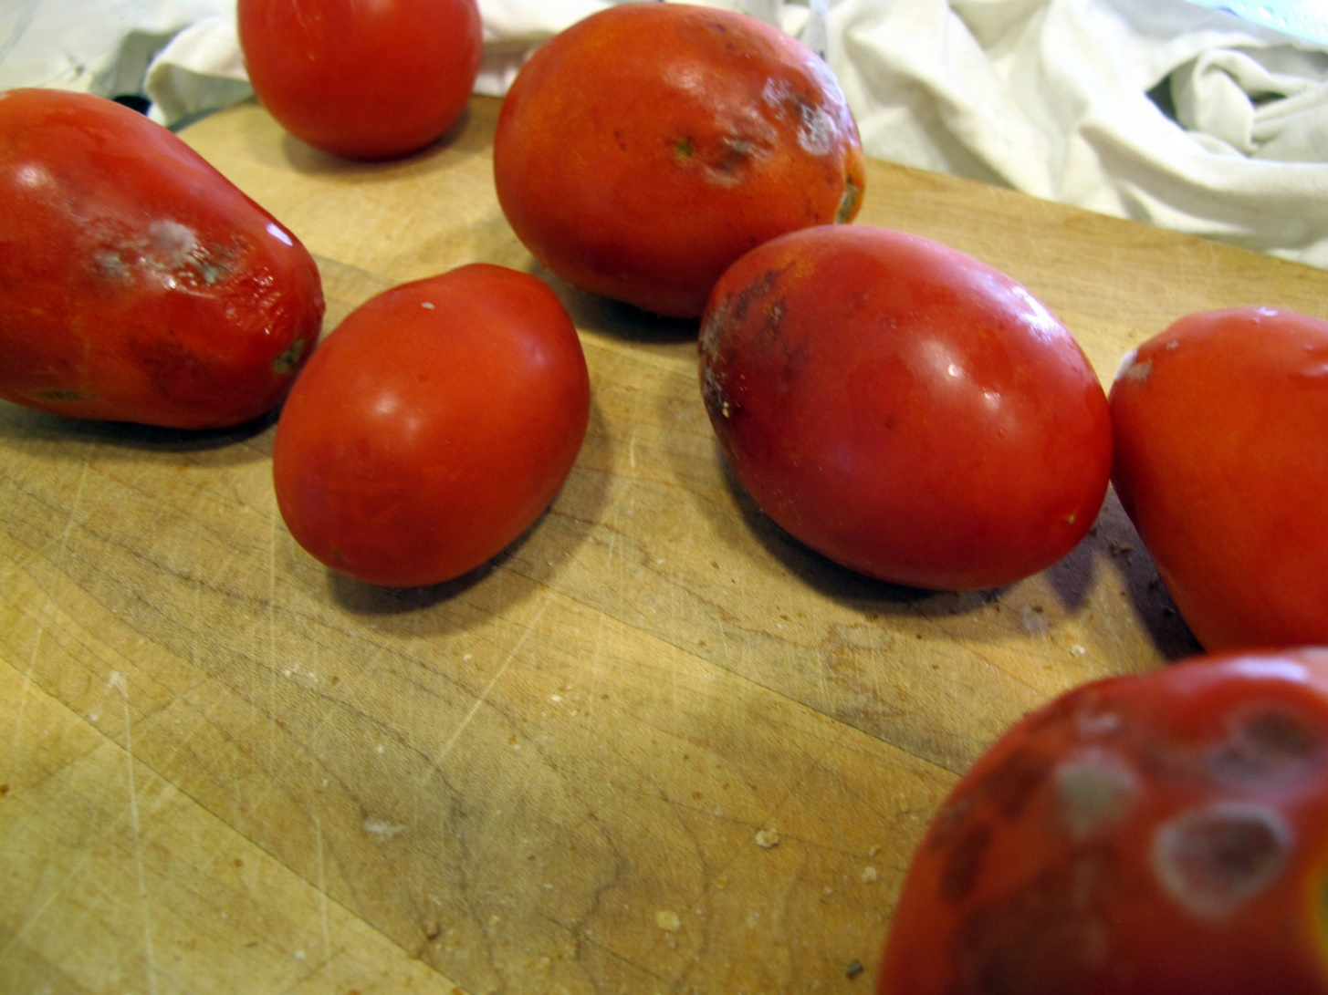
4. Bedorven of niet bedorven?
Bron: Christopher Porter https://www.flickr.com/photos/canadianveggie/15573991455/in/photolist-pJdM54-8C11t3-BKvNF8-jue897-cGLHrf-6e75d7-fXWK89-4V1ikT-eRBJVH-7GuFsC-6HC9uw-jUQbfv-juq8Z2-8DpQqx-4F97NE-6m61o7-eapzHc-ktR2t-9VGg9X-eapzLV-eapzAi-eapzEk-oY6qm6-pUXXK3-4V1huT-skyMVy-akuvzN-5sLHbT-pUDVfP-68MWXA-6Hb5c-68HK4v-5LYn1-4KSH2m-bmfLxs-bzaDop-rYiTu-2EMaY-9qiP2j-qXbntF-dcqHR1-8sKo4n-7J9aM-4yTv5C-7vdrPb-6HR9Dm-7nCQvY-fXWyHj-tAzbu-7jRmcV
Notes:
Bedorven: tomaat

Slide 6
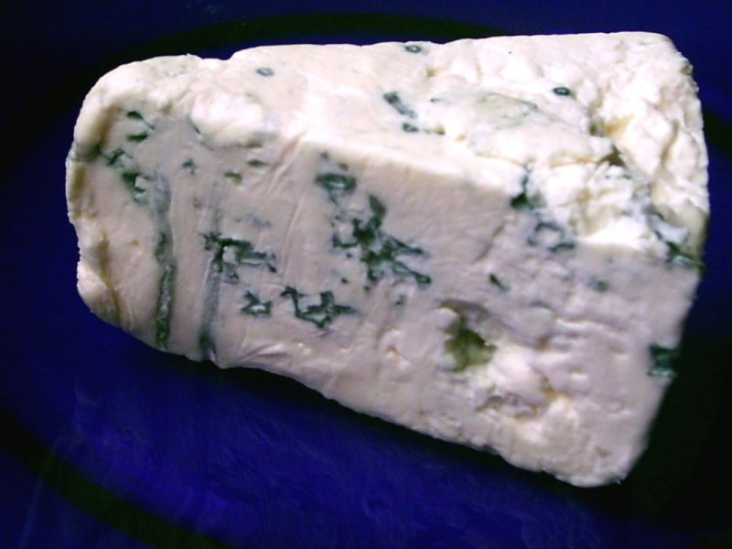
5. Bedorven of niet bedorven?
Bron: Zerohund https://nl.wikipedia.org/wiki/Schimmelkaas#/media/File:Blauschimmelk%C3%A4se.jpg
Notes:
Niet bedorven: schimmelkaas

Slide 7
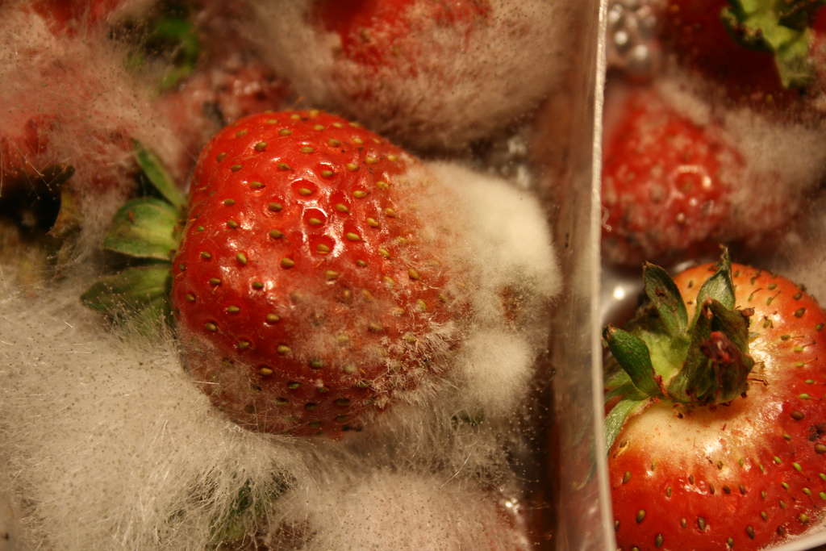
6. Bedorven of niet bedorven?
Bron: Mella Estkling https://www.flickr.com/photos/estkling/2066545429/in/photolist-49BzXB-83mHkU-HeYDv-iQfTDx-8bqf59-nMSPga-68BrB4-2tZ2Hw-4nnErA-34fyZ1-49FHaE-4nFk3Z-8cbuvR-49FLGY-gqXxaA-49BEWi-3KDX9m-N2WbF-52T3zF-49FJdd-49FK8d-49Fzj3-49FMEy-xcicC-j25NX-oxdNjk-49FE9h-6WE6r-5SiD3u-49BvYF-49BwXD-5mM5aW-49FD9q-hmXS6X-ovsX6p-bn1ttm-6EGyFy-T8GU1-3zSZGJ-49Bv3F-8Ckjgc-8ATLNE-tVVmN-49BACH-gLDrv-FVMQg-5ocgvK-8TJJp6-5hcrRk-iYw4Xv
Notes:
Bedorven: aardbei

Slide 8
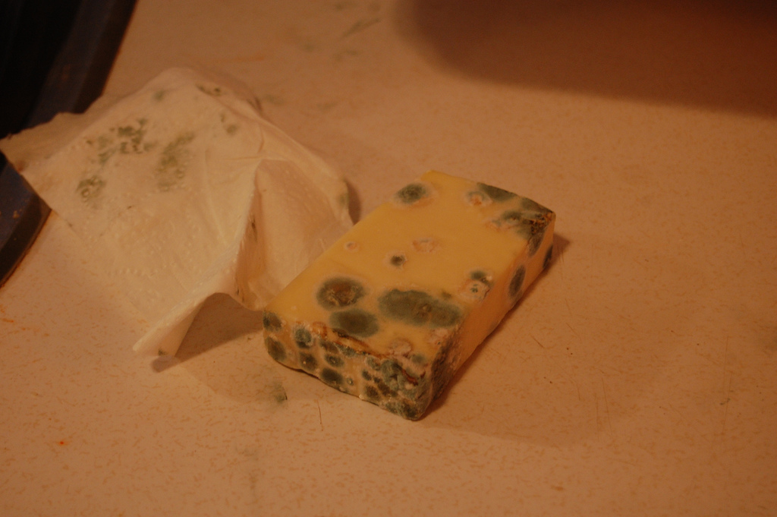
7. Bedorven of niet bedorven?
Bron: smiditch357 https://www.flickr.com/photos/8021151@N06/3316987493/in/photolist-647qPx-bJfySR-REhTqW-QDNkD4-8oaQn1-8o7EoH-oDdr2-RUqoLp-7MH7F6-sS5XT-bDz5fp-5wg41x-7p1VuD-e2iqCj-zodiLW-o2ESpY-oG96ZU-aNGsx-7worNx-7p1Vy4-5XxYr9-q7gf19-91so7a-7vGddt-9pqjPR-8Y5wQ-bE49VM-3QbZvT-6qw6tB-4Girc3-pBUvje-4gnD1-5qezBV-aHGf1a-aqpDJX-czCW6-anecGY-6LQUdg-a238X-eCiS9-4fWDN-9aMNAe-jGhNr-LcLZq-7mGapC-ghTzQk-HeYDv-aWWqZR-8uWFKg-p94119
Notes:
Bedorven: kaas

Slide 9
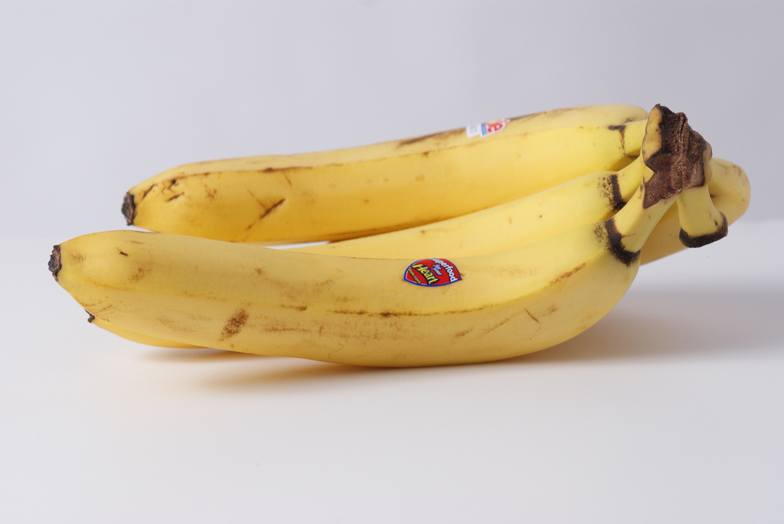
8. Bedorven of niet bedorven?
Bron: Todd Moore https://www.flickr.com/photos/mooreluv/3231118036/in/photolist-5VwjPE-fzzxwq-fmW61-bNJD5i-7ZB8Vt-9ax5TW-qBW7t-3TKiWx-7621fo-8fWKtb-fPieh-SdnC3t-8tAWKc-4wGtM7-2mmMo-9vhkow-9sU3zq-9sR35i-RJMWFQ-4rxB4J-HpCsQ6-7WrbsC-9aJ6a2-oDYAY-8VcYVj-5n5QXg-6bvEPq-6wRRC1-9Ryw9-qCkjp-bsveWe-kaZspr-9wAYSg-6bK62e-baqraM-bxLiha-S6MHT-9AMvSU-4SsfY6-DvKyF-7xaU4G-4WYuAg-93iRxd-nw8Rrn-NnPYN-8warwk-9TzK9D-9f1dUi-ovAg2V-aqfSk3
Notes:
Niet bedorven: banaan

Slide 10
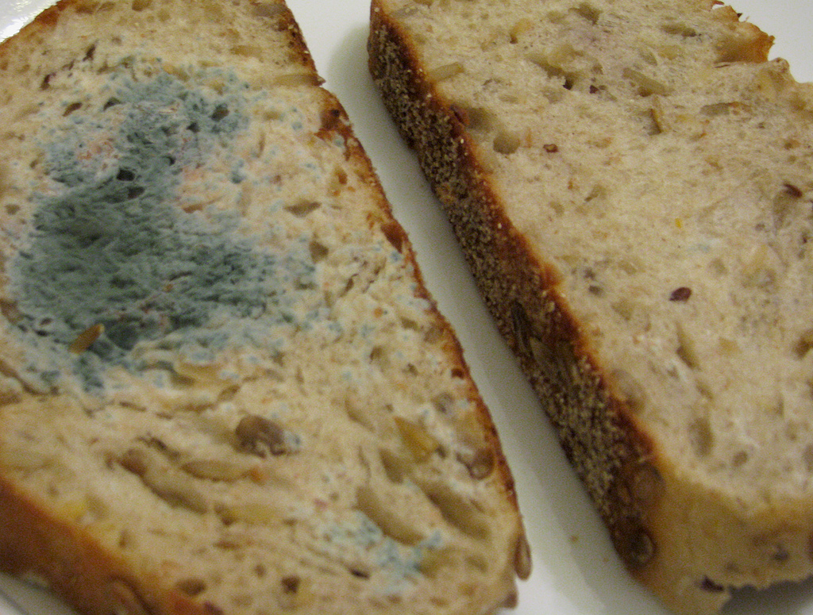
9. Bedorven of niet bedorven?
Bron: Rosanna Lui https://www.flickr.com/photos/iliketodrawonthewalls/6686747927/in/photolist-4jvjYs-au2D8W-wNBik-9v2QVs-bM387-5img91-5o2Ywq-bbTkcn-61nJzd-4RJmc1-AQdCT-6a6Vxg-7vD3hT-4RJmbS-9YeQ7G-qjD6V5-c9fYwb-6WsoDP-4SAoq-4VMxtP-9e1q4i-6LEndk-8BWwUo-4nCYiC-8EnyE6-jusTv-6qj9Hv-8NAEfH-a2mjK2-jVosPj-9wzMZ-8cSexw-6kLtHQ-kd2GFX-4WUkYB-7iy2nk-4WYzMo-QbLvq-4WUjtv-Ao5h-pqjjLa-8Uu9CF-4WUkrr-aFNHdK-4WUijR-e316To-dBhnxa-FBkjH-dAKZkd-6LEnnP
Notes:
Bedorven: brood

